Slide 1


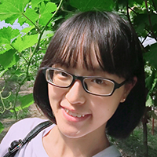
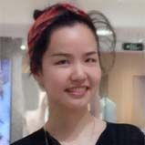
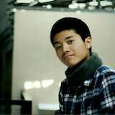


AI-Sketcher: A Deep Generative Model
for Generating High Quality Sketches
Nan Cao, Xin Yan, Yang Shi, Chaoran Chen
Intelligent Big Data Visualization Lab
Tongji University

Slide 2
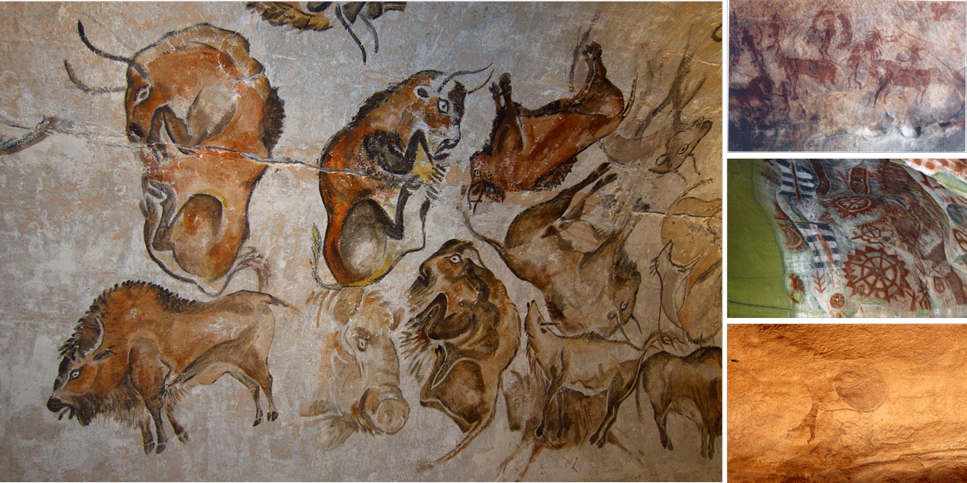
BACKGROUND - Cave Painting
Notes:
Sketch drawings play an important role in assisting humans in communication and creative design since the ancient times. It is a creating behavior that reveals our mind.

Slide 3
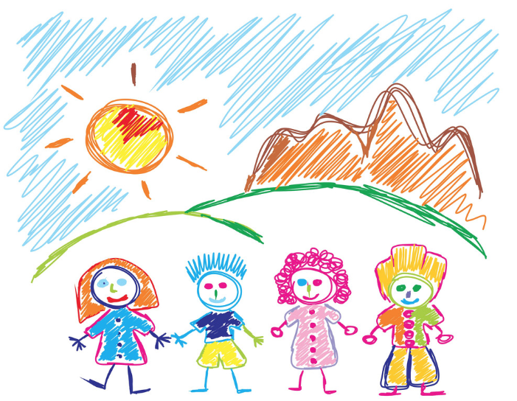
BACKGROUND - Children’s Drawings
Notes:
Sketch drawings play an important role in assisting humans in communication and creative design since the ancient times. It is a creating behavior that reveals our mind.

Slide 4
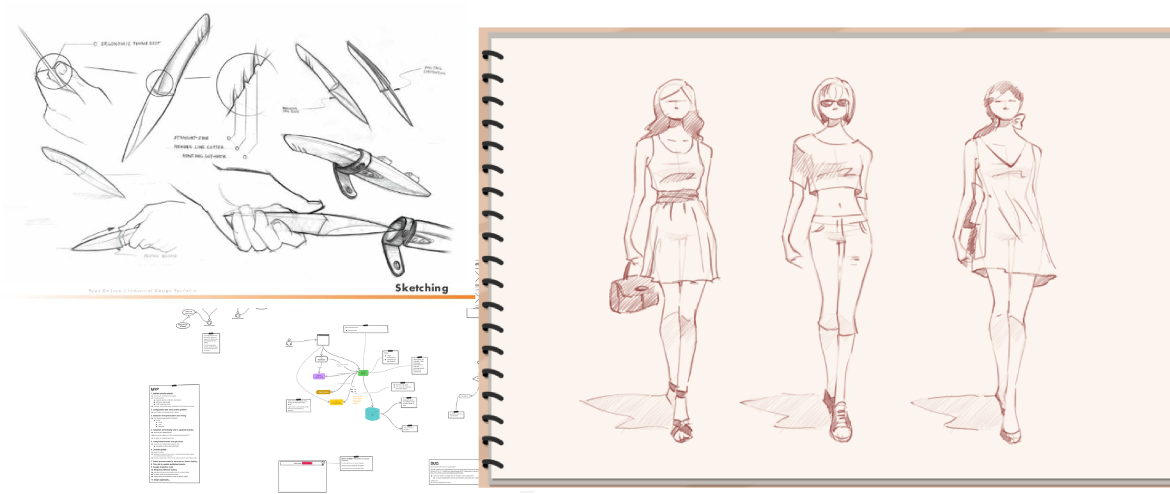
BACKGROUND - Design Sketches
Notes:
Sketch drawings play an important role in assisting humans in communication and creative design since the ancient times. It is a creating behavior that reveals our mind.

Slide 5
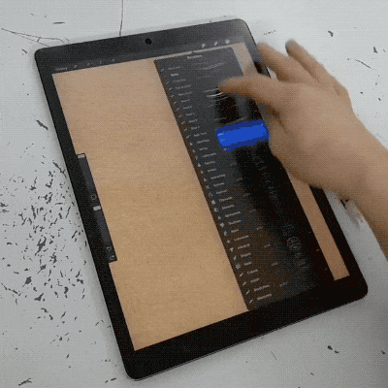
BACKGROUND - Design Sketches
Notes:
Sketch drawings play an important role in assisting humans in communication and creative design since the ancient times. It is a creating behavior that reveals our mind.

Slide 6

Can AI help designers create high quality sketches and boost their productivity and creativity?

Slide 7
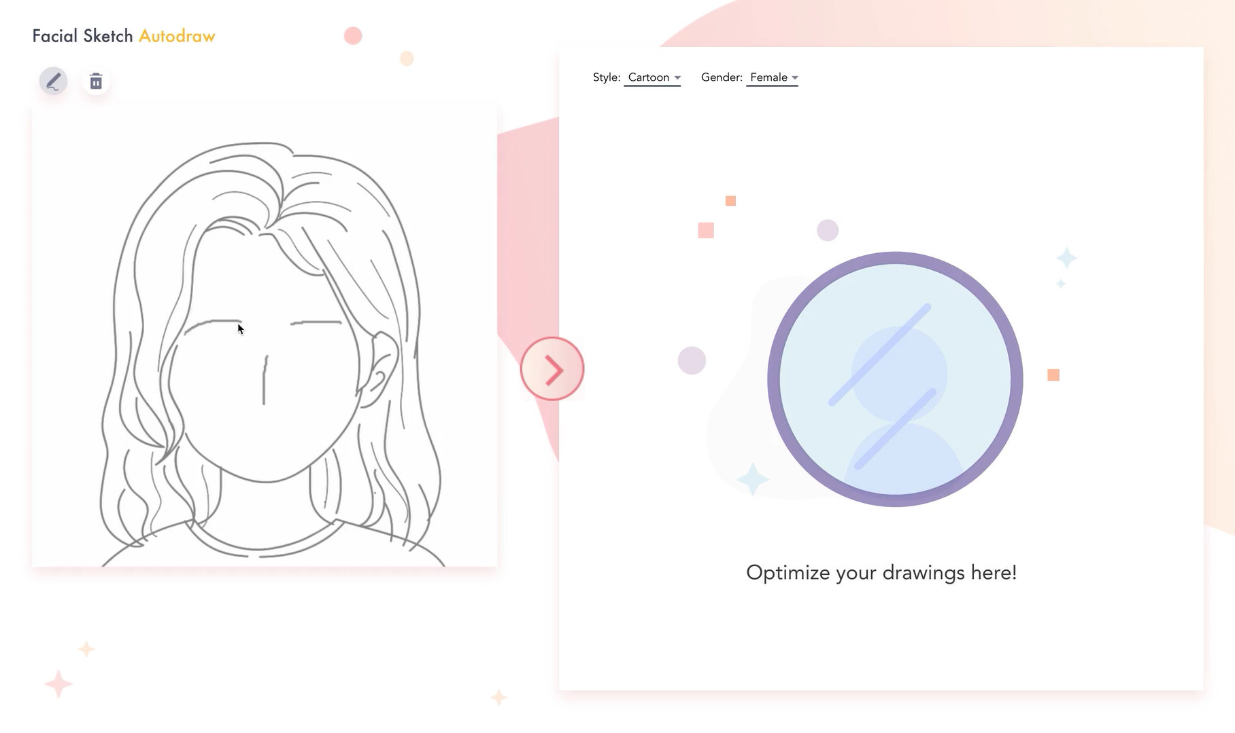

Slide 8
CHARACTERISTICS OF SKETCHING
Multiple steps
Stroke by stroke
Only line matters

Slide 9
Reference Pipeline for AI-Supported Sketching
1
2
3
Stroke Encoding
Learning
Generating

Slide 10
Stroke Encoding
Stroke Encoding
Learning
Generating
continuous
one-hot
[△x, △y, p₁, p₂, p₃]
Start coordinates relative to the end of last stroke
continuous
drawing from the last point,
end of drawing a stroke
end of drawing a sketch
——“A Neural Representation of Sketch Drawings”
Notes:
Sketch-RNN is a sequence-to-sequence variational autoencoder (VAE) introduced to generate sketches in a stroke by stroke manner.

Slide 11
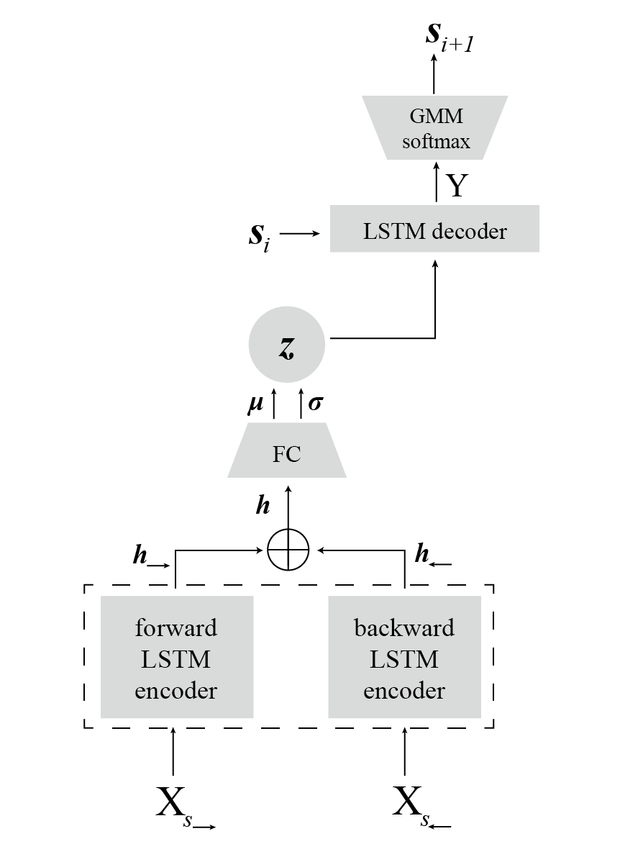
Learning (Sketch-RNN)
Stroke Encoding
Learning
Generating
Current Stroke
——“A Neural Representation of Sketch Drawings”
Notes:
Sketch-RNN is a sequence-to-sequence variational autoencoder (VAE) introduced to generate sketches in a stroke by stroke manner.

Slide 12
Learning (Sketch-RNN)
Stroke Encoding
Learning
Generating
Encoder: Bidirectional RNN (BRNN)
Current Stroke
——“A Neural Representation of Sketch Drawings”
Notes:
Sketch-RNN is a sequence-to-sequence variational autoencoder (VAE) introduced to generate sketches in a stroke by stroke manner.

Slide 13
Learning (Sketch-RNN)
Stroke Encoding
Learning
Generating
Latent Vector Capturing the drawing behaviors
Latent Vector Capturing the drawing behaviors
Encoder: Bidirectional RNN (BRNN)
Current Stroke
Current Stroke
——“A Neural Representation of Sketch Drawings”
Notes:
Sketch-RNN is a sequence-to-sequence variational autoencoder (VAE) introduced to generate sketches in a stroke by stroke manner.

Slide 14
Learning (Sketch-RNN)
Stroke Encoding
Learning
Generating
Distribution of strokes
Latent Vector Capturing the drawing behaviors
Encoder: Bidirectional RNN (BRNN)
Current Stroke
Current Stroke
——“A Neural Representation of Sketch Drawings”
Notes:
Sketch-RNN is a sequence-to-sequence variational autoencoder (VAE) introduced to generate sketches in a stroke by stroke manner.

Slide 15
Learning (Sketch-RNN)
Stroke Encoding
Learning
Generating
Random Sampling for Stroke Generation
Distribution of strokes
Latent Vector Capturing the drawing behaviors
Encoder: Bidirectional RNN (BRNN)
Current Stroke
Current Stroke
——“A Neural Representation of Sketch Drawings”
Notes:
Sketch-RNN is a sequence-to-sequence variational autoencoder (VAE) introduced to generate sketches in a stroke by stroke manner.

Slide 16
Learning (Sketch-RNN)
Stroke Encoding
Learning
Generating
Decoder
Random Sampling for Stroke Generation
Distribution of strokes
Latent Vector Capturing the drawing behaviors
Encoder: Bidirectional RNN (BRNN)
Current Stroke
Current Stroke
——“A Neural Representation of Sketch Drawings”
Notes:
Sketch-RNN is a sequence-to-sequence variational autoencoder (VAE) introduced to generate sketches in a stroke by stroke manner.

Slide 17
Learning (Sketch-RNN)
Vector of the next Stroke
Stroke Encoding
Learning
Generating
Decoder
Random Sampling for Stroke Generation
Distribution of strokes
Latent Vector Capturing the drawing behaviors
Encoder: Bidirectional RNN (BRNN)
Current Stroke
Current Stroke
——“A Neural Representation of Sketch Drawings”
Notes:
Sketch-RNN is a sequence-to-sequence variational autoencoder (VAE) introduced to generate sketches in a stroke by stroke manner.

Slide 18
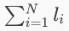
Learning (Sketch-RNN)
Stroke Encoding
Learning
Generating
LOSS Function :
——“A Neural Representation of Sketch Drawings”

Slide 19
Learning (Sketch-RNN)
Stroke Encoding
Learning
Generating
LOSS Function :
——“A Neural Representation of Sketch Drawings”

Slide 20
Learning (Sketch-RNN)
Stroke Encoding
Learning
Generating
LOSS Function :
Reconstruction Loss
Expected negative log-likelihood of the i-th image
Encourages the decoder to learn to reconstruct the data
——“A Neural Representation of Sketch Drawings”

Slide 21
Learning (Sketch-RNN)
Stroke Encoding
Learning
Generating
LOSS Function :
KL Loss
Measure of how close q is to p = N(0,1)
——“A Neural Representation of Sketch Drawings”

Slide 22
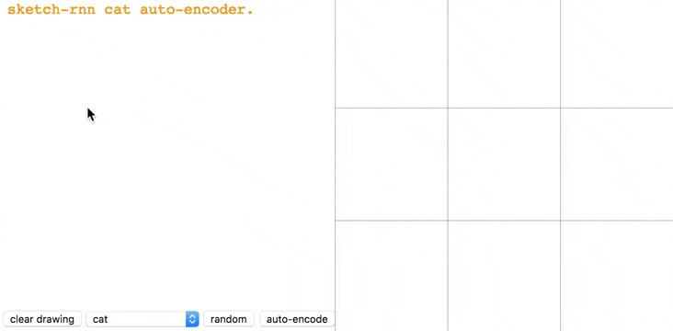
Generating (Sketch-RNN)
Stroke Encoding
Learning
Generating
——“A Neural Representation of Sketch Drawings”

Slide 23
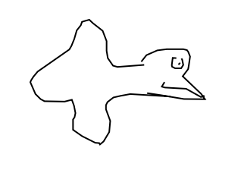
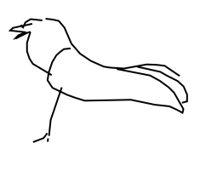
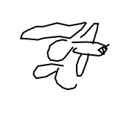
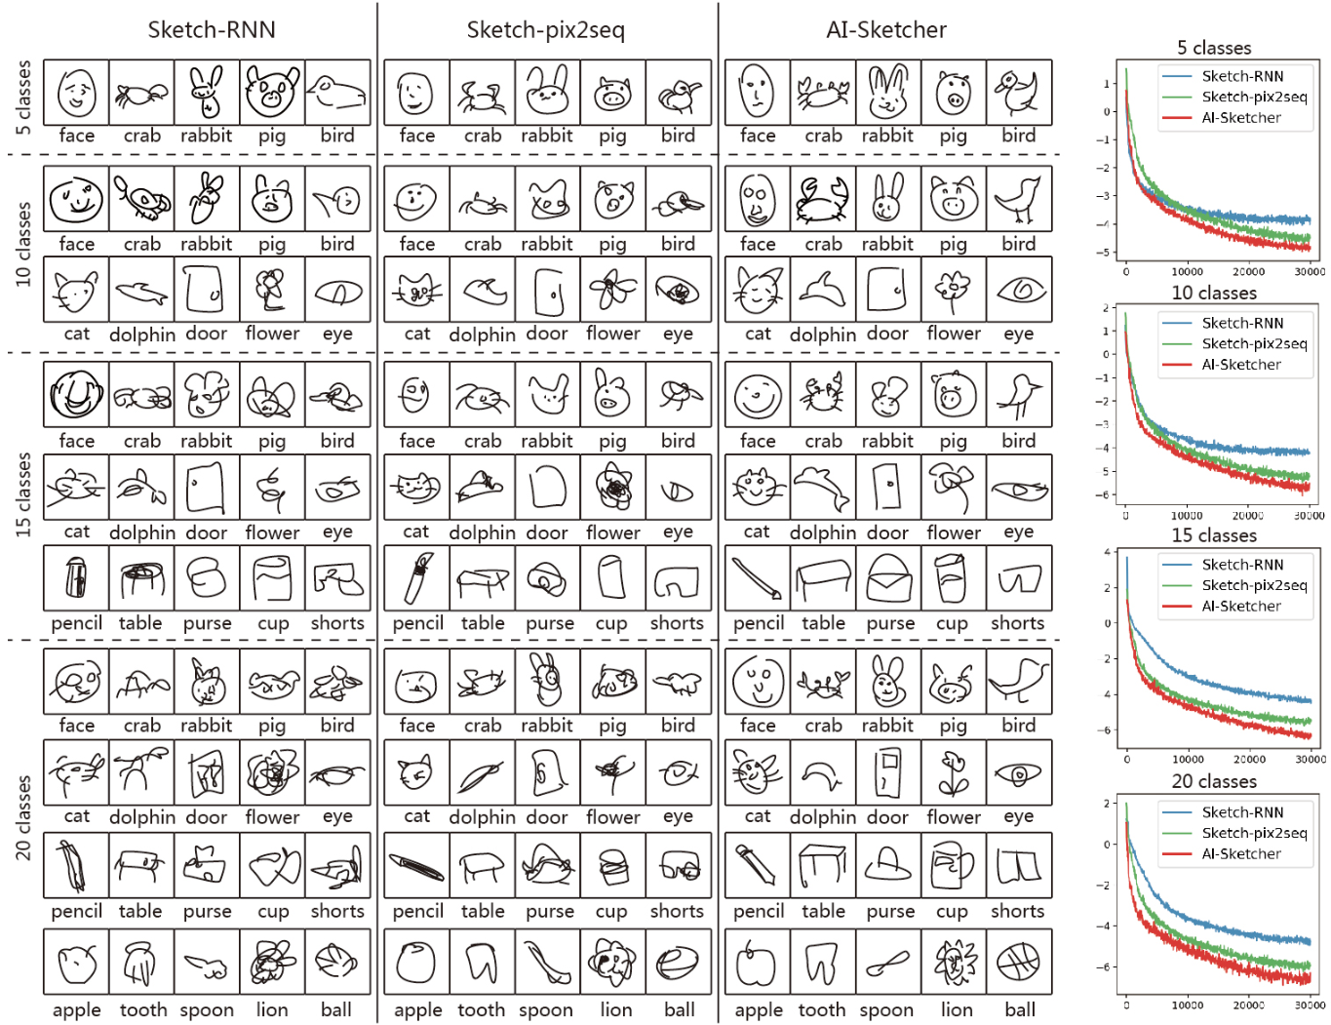
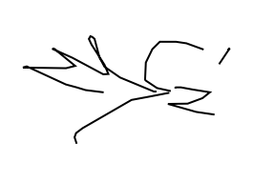
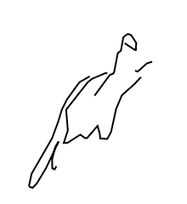
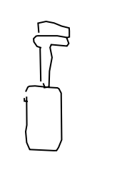
LIMITATION OF SKETCH-RNN
Low quality
1. generating sketches in one category (bird).
2. dealing with multi-class situations
——“A Neural Representation of Sketch Drawings”
Notes:
(1) it only captures sequential orders of strokes, but fails to precisely preserve the relative positions between strokes. Therefore, it usually
generates low quality results when a sketch consists of multiple parts.
(2) Sketch-RNN is also incapable of dealing with multi-class situations and frequently generates incoherent sketches that integrate features
from other sketch categories

Slide 24
AI-Sketcher
a hybrid deep learning model to automatically generate high quality sketch drawings by learning sequences of strokes
Notes:
To address the above issues, in this paper, we introduce AI-Sketcher, a hybrid deep learning model to automatically generate high quality sketch drawings by learning sequences of strokes.

Slide 25
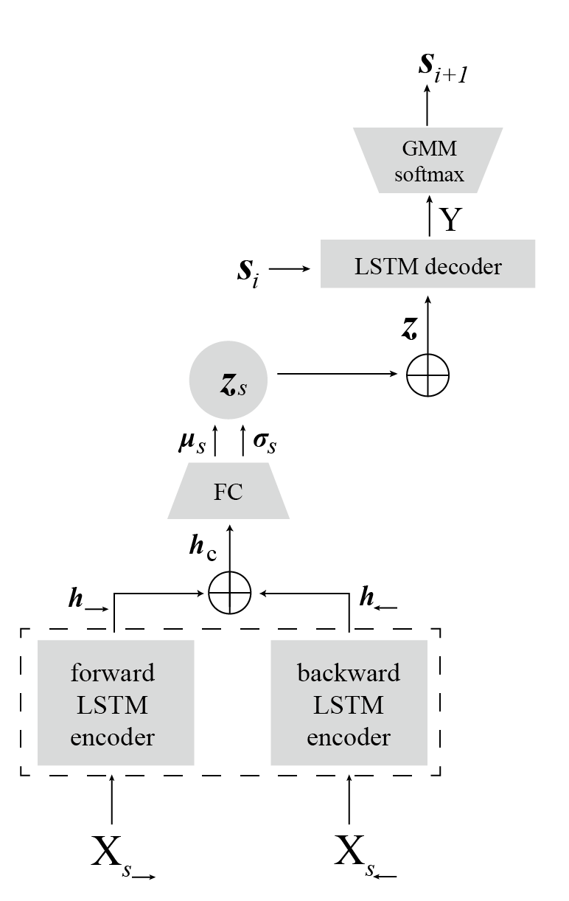
AI-SKETCHER

Slide 26
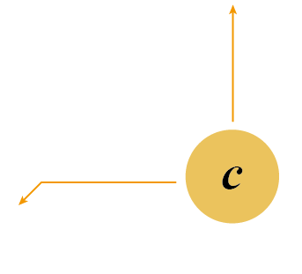
AI-SKETCHER
A conditional vector is used to ensure a high quality generation of sketches from multiple categories.

Slide 27
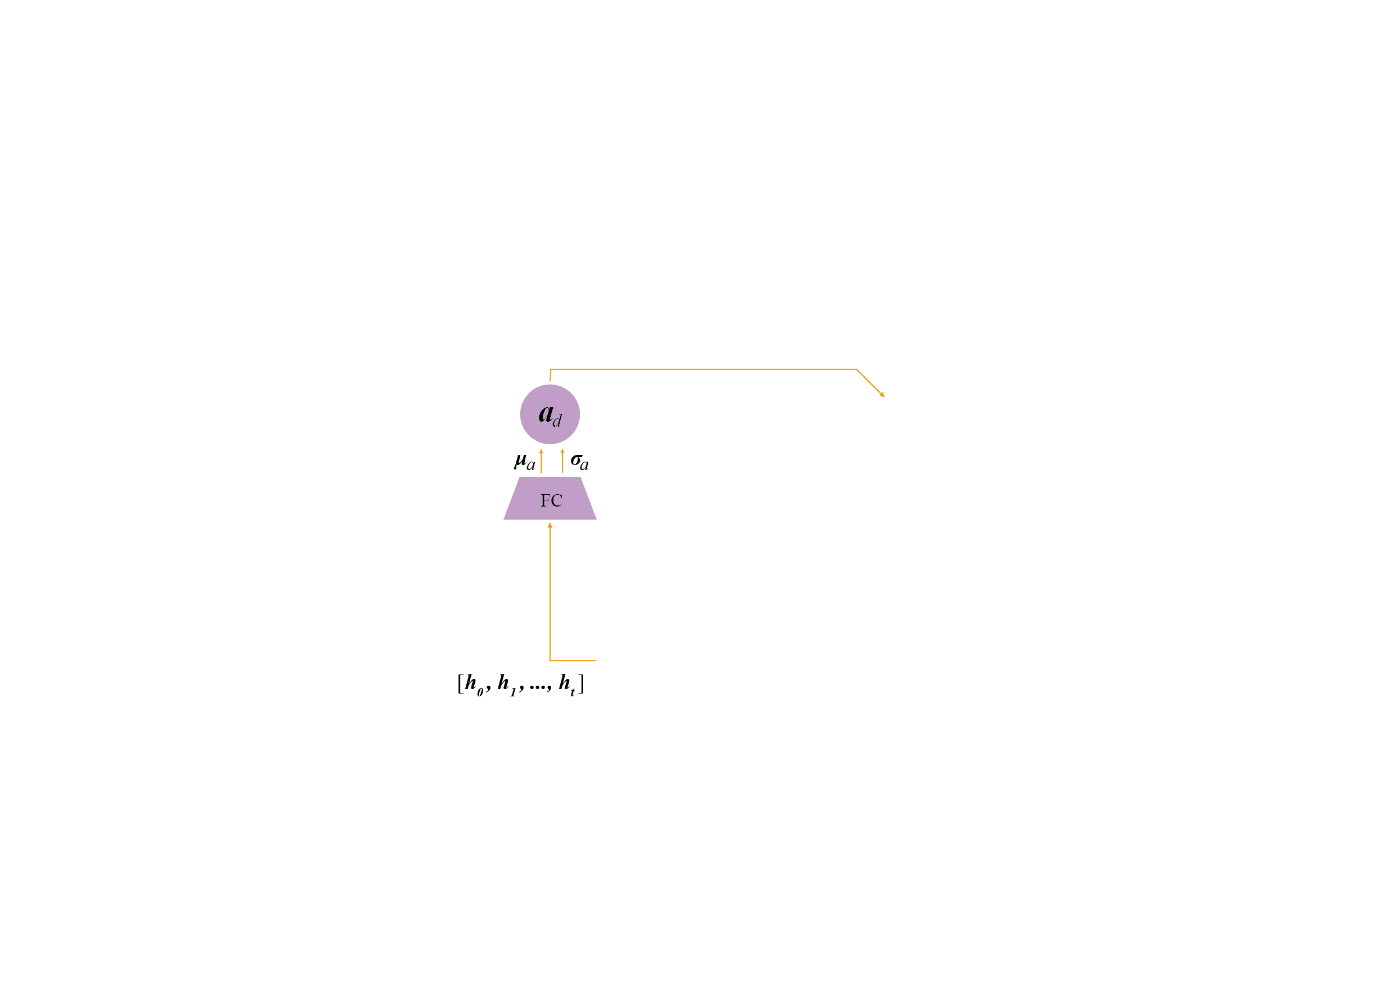
AI-SKETCHER
A conditional vector is used to ensure a high quality generation of sketches from multiple categories.
A fully-connected layer is introduced to estimate how the previous strokes will influence on the next stroke.

Slide 28
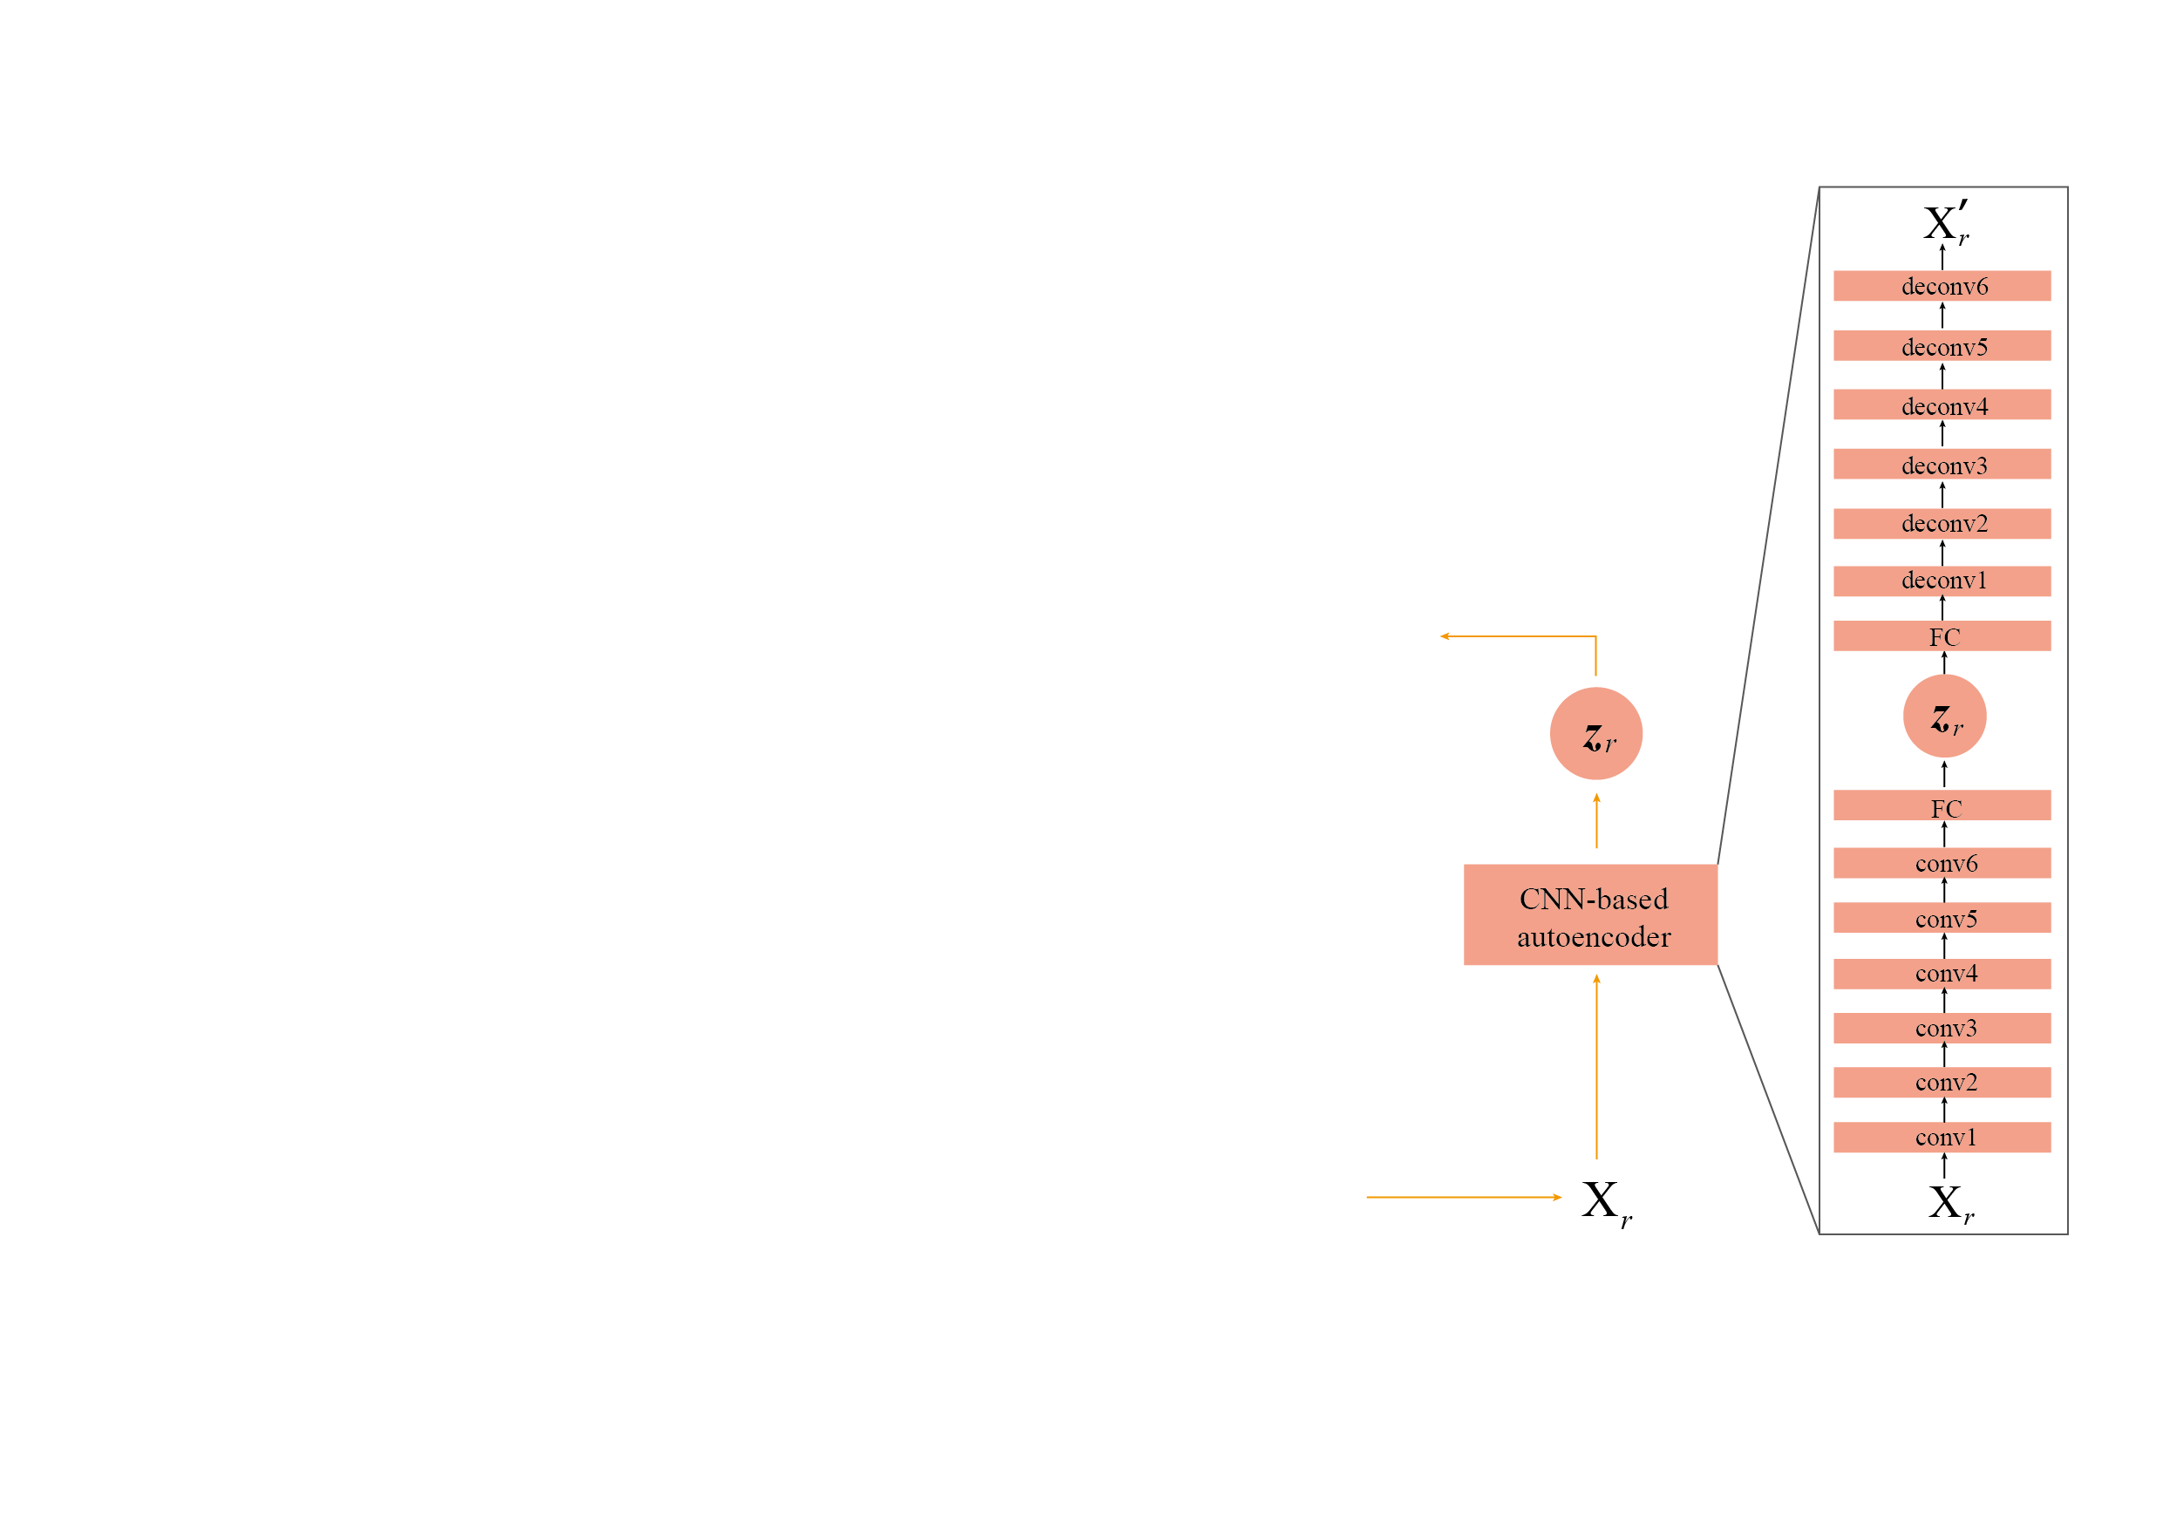
AI-SKETCHER
A conditional vector is used to ensure a high quality generation of sketches from multiple categories.
A fully-connected layer is introduced to estimate how the previous strokes will influence on the next stroke.
A CNN-based autoencoder is employed to capture the spatial information of a training set.

Slide 29
AI-SKETCHER
A conditional vector is used to ensure a high quality generation of sketches from multiple categories.
A fully-connected layer is introduced to estimate how the previous strokes will influence on the next stroke.
A CNN-based autoencoder is employed to capture the spatial information of a training set.
Loss function is modified.

Slide 30
AI-SKETCHER
A conditional vector is used to ensure a high quality generation of sketches from multiple categories.
A fully-connected layer is introduced to estimate how the previous strokes will influence on the next stroke.
A CNN-based autoencoder is employed to capture the spatial information of a training set.
Loss function is modified.

Slide 31
AI-SKETCHER
A conditional vector is used to ensure a high quality generation of sketches from multiple categories.
A fully-connected layer is introduced to estimate how the previous strokes will influence on the next stroke.
A CNN-based autoencoder is employed to capture the spatial information of a training set.
Loss function is modified.

Slide 32
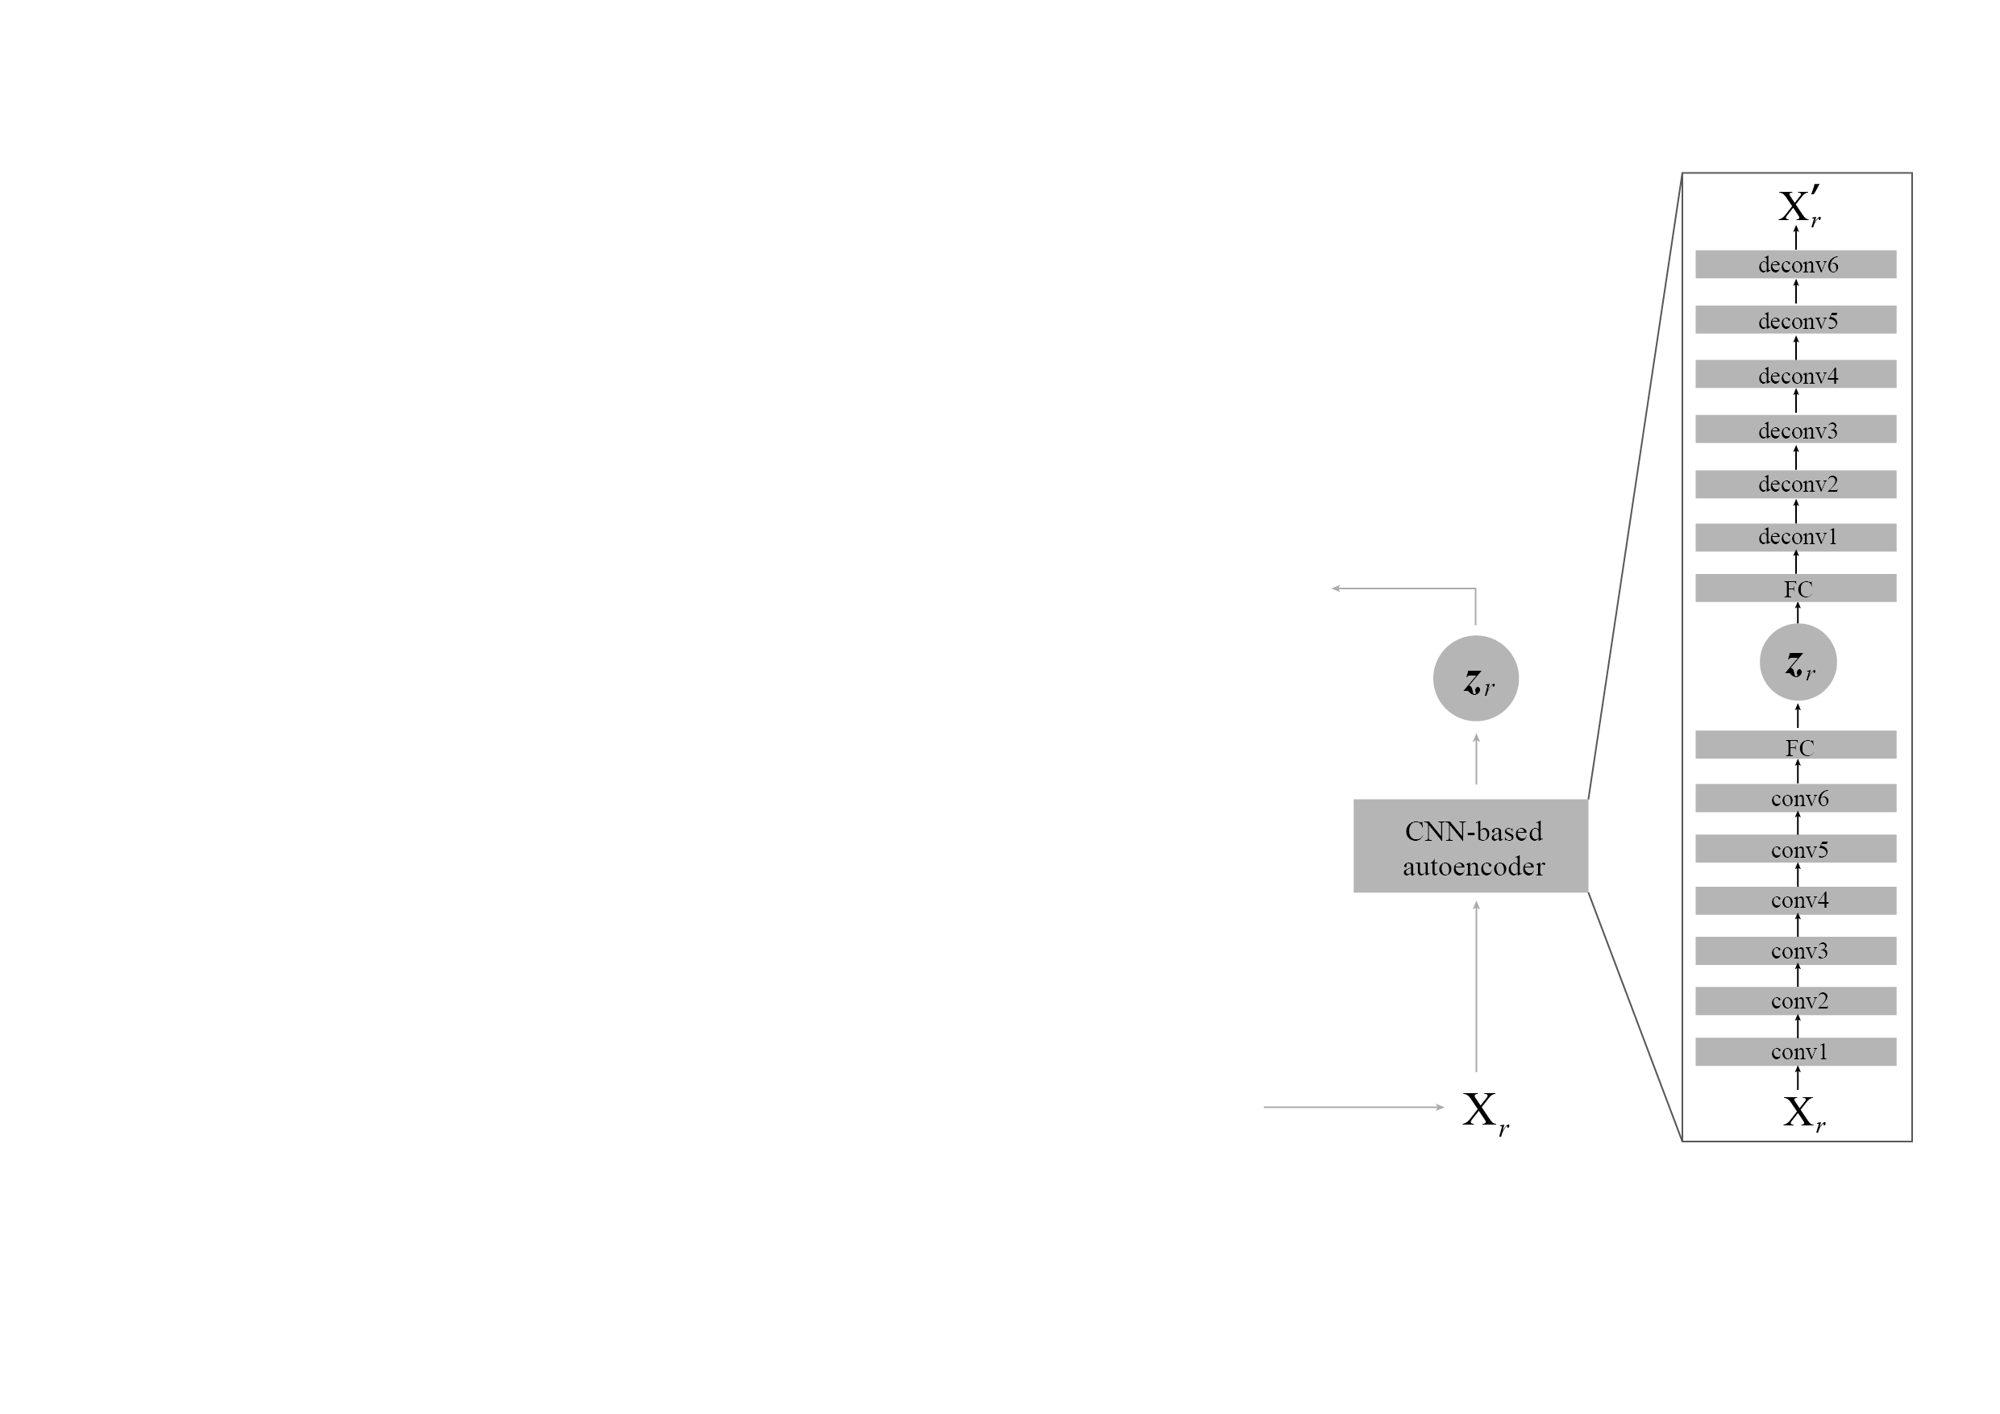
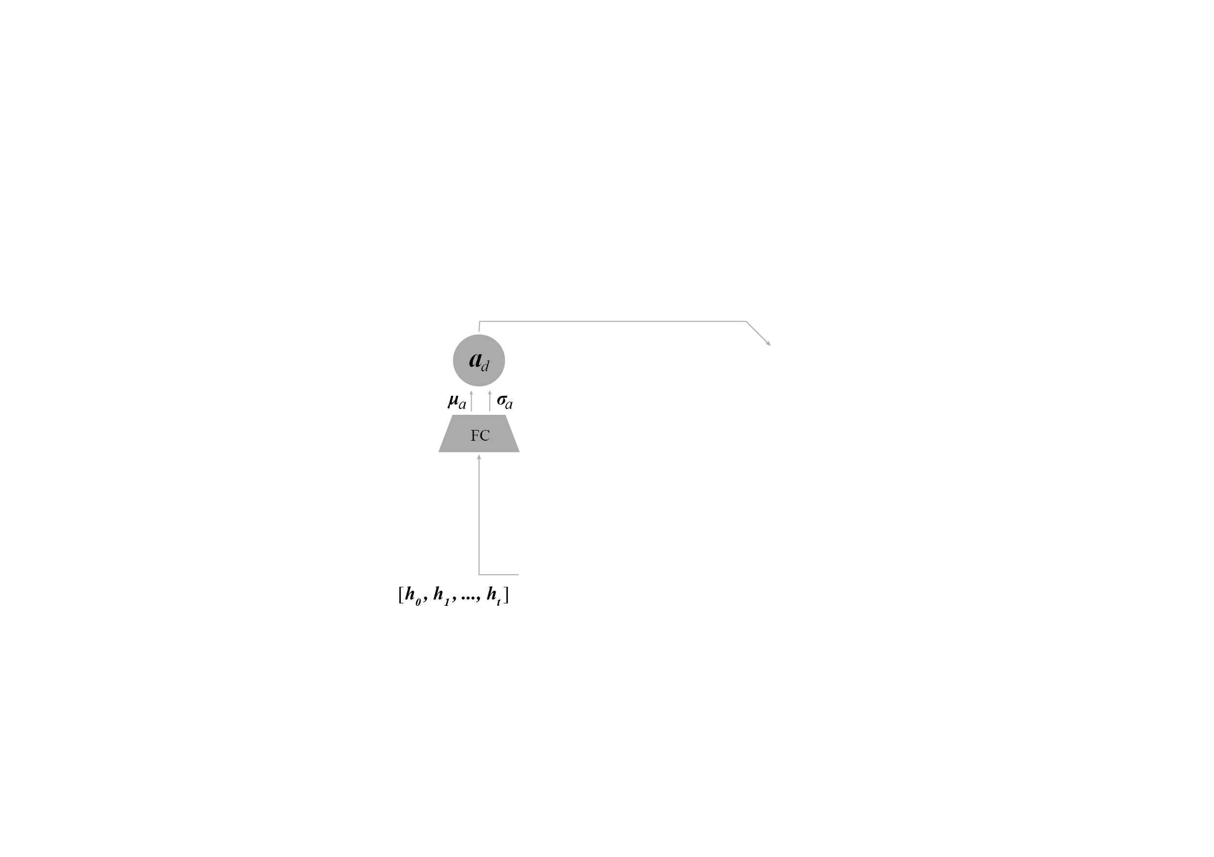
AI-SKETCHER - Conditional Sequence-to-Sequence VAE
A conditional vector is used to ensure a high quality generation of sketches from multiple categories.

Slide 33
AI-SKETCHER - Conditional Sequence-to-Sequence VAE
A conditional vector is used to ensure a high quality generation of sketches from multiple categories.
Encoder: Bidirectional RNN

Slide 34
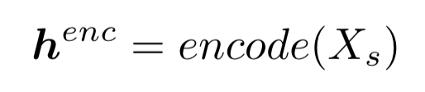
AI-SKETCHER - Conditional Sequence-to-Sequence VAE
A conditional vector is used to ensure a high quality generation of sketches from multiple categories.
Xs: the sequences of strokes.

Slide 35
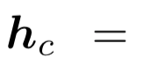
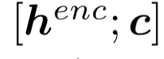
AI-SKETCHER - Conditional Sequence-to-Sequence VAE
A conditional vector is used to ensure a high quality generation of sketches from multiple categories.
c is a k-dimensional one-hot conditional vector with k indicates the number of conditions.

Slide 36
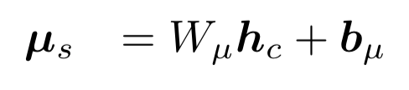
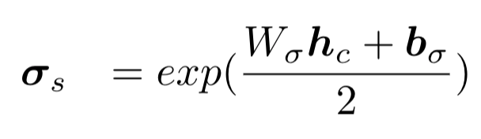
AI-SKETCHER - Conditional Sequence-to-Sequence VAE
A conditional vector is used to ensure a high quality generation of sketches from multiple categories.
hc is further transformed into two vectors to capture the distributions of the training strokes:

Slide 37
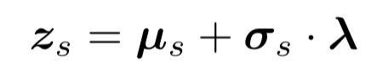
AI-SKETCHER - Conditional Sequence-to-Sequence VAE
A conditional vector is used to ensure a high quality generation of sketches from multiple categories.
A latent vector has been randomly sampled from the distributions for generating the next strokes:

Slide 38
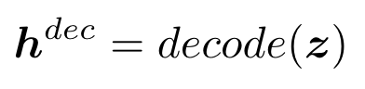
AI-SKETCHER - Conditional Sequence-to-Sequence VAE
A conditional vector is used to ensure a high quality generation of sketches from multiple categories.
For decoding
zs is concatenated together with the image feature vector zr, the latent influence vector ad, the conditional vector c and the last stroke vector si:
z = [zs; zr; ad; c; si]

Slide 39
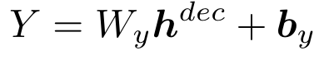
AI-SKETCHER - Conditional Sequence-to-Sequence VAE
A conditional vector is used to ensure a high quality generation of sketches from multiple categories.
Y: the parameters of a Gaussian mixture model (GMM) employed for predicting the next stroke.

Slide 40
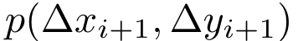
AI-SKETCHER - Conditional Sequence-to-Sequence VAE
A conditional vector is used to ensure a high quality generation of sketches from multiple categories.
predict the probabilities of the relative position of the next drawing point:

Slide 41
AI-SKETCHER
A conditional vector is used to ensure a high quality generation of sketches from multiple categories.
A fully-connected layer is introduced to estimate how the previous strokes will influence on the next stroke.
A CNN-based autoencoder is employed to capture the spatial information of a training set.
Loss function is modified.

Slide 42
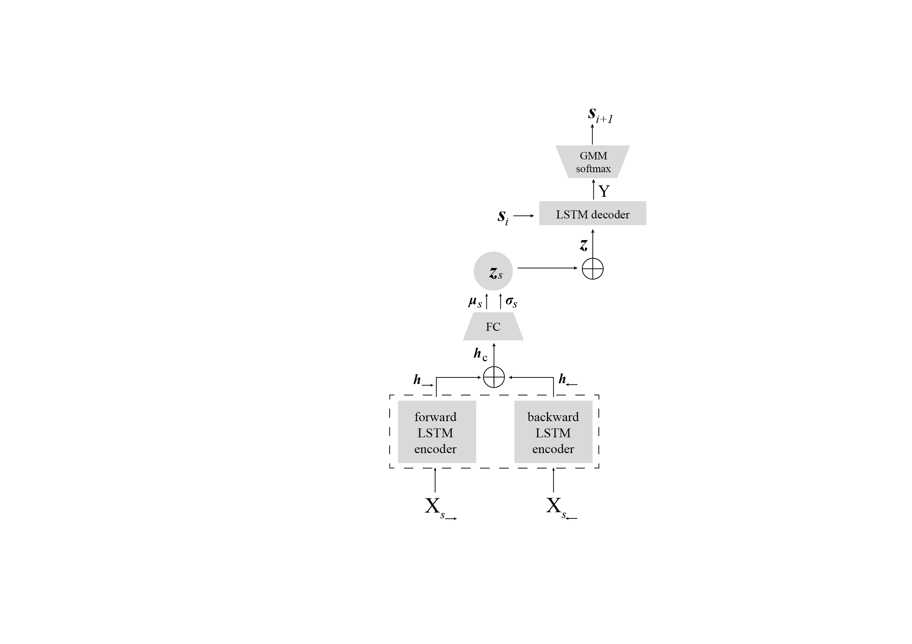

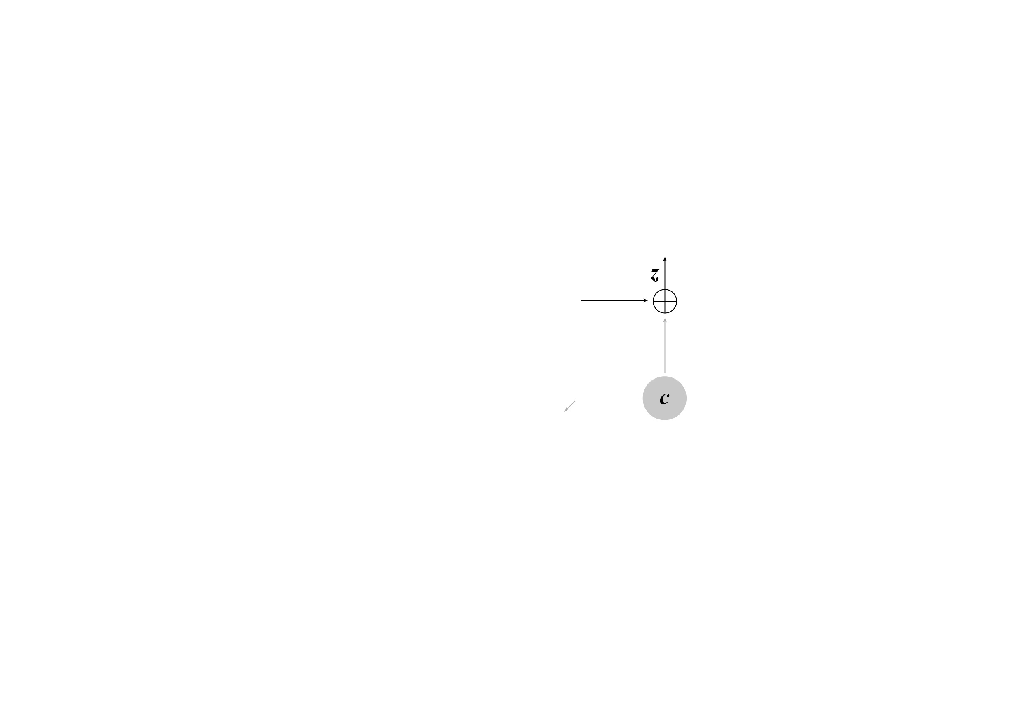
AI-SKETCHER
A conditional vector is used to ensure a high quality generation of sketches from multiple categories.
A fully-connected layer is introduced to estimate how the previous strokes will influence on the next stroke.
A CNN-based autoencoder is employed to capture the spatial information of a training set.
Loss function is modified.

Slide 43
AI-SKETCHER - Influence Layer
A fully-connected layer is introduced to estimate how the previous strokes will influence on the next stroke.

Slide 44
AI-SKETCHER - Influence Layer
A fully-connected layer is introduced to estimate how the previous strokes will influence on the next stroke.
The influence layer is applied to enhance the influence of the input training data on the decoding process.

Slide 45
AI-SKETCHER - Influence Layer
A fully-connected layer is introduced to estimate how the previous strokes will influence on the next stroke.
It considers all the previous hidden node values until the latest drawing step in the RNN encoder.

Slide 46
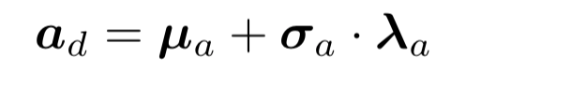
AI-SKETCHER - Influence Layer
A fully-connected layer is introduced to estimate how the previous strokes will influence on the next stroke.
The influence vector ad is a latent vector whose fields are sampled from these normal distributions:

Slide 47
AI-SKETCHER
A conditional vector is used to ensure a high quality generation of sketches from multiple categories.
A fully-connected layer is introduced to estimate how the previous strokes will influence on the next stroke.
A CNN-based autoencoder is employed to capture the spatial information of a training set.
Loss function is modified.

Slide 48
AI-SKETCHER
A conditional vector is used to ensure a high quality generation of sketches from multiple categories.
A fully-connected layer is introduced to estimate how the previous strokes will influence on the next stroke.
A CNN-based autoencoder is employed to capture the spatial information of a training set.
Loss function is modified.

Slide 49
AI-SKETCHER - CNN-based Autoencoder
A CNN-based autoencoder is employed to capture the spatial information of a training set.

Slide 50
AI-SKETCHER - CNN-based Autoencoder
A CNN-based autoencoder is employed to capture the spatial information of a training set.
Xr: the input raster image matrix.
Notes:
To captures the pixel arrangements of the input sketches…
We introduce CNN-based Autoencoder.

Slide 51
AI-SKETCHER - CNN-based Autoencoder
A CNN-based autoencoder is employed to capture the spatial information of a training set.
Encoder:
three convolutional layers with the stride size as 2.
the other three layers with the stride size as 1.
Notes:
To captures the pixel arrangements of the input sketches…
We introduce CNN-based Autoencoder.

Slide 52
AI-SKETCHER - CNN-based Autoencoder
A CNN-based autoencoder is employed to capture the spatial information of a training set.
Encoder:
The last layer is a fully-connected neural network to produce the latent feature vector zr with 128 dimensions.
Notes:
To captures the pixel arrangements of the input sketches…
We introduce CNN-based Autoencoder.

Slide 53
AI-SKETCHER - CNN-based Autoencoder
A CNN-based autoencoder is employed to capture the spatial information of a training set.
Decoder:
three deconvolutional layers with stride sizes equal to 2.
the other three layers with stride sizes equal to 1.
Notes:
To captures the pixel arrangements of the input sketches…
We introduce CNN-based Autoencoder.

Slide 54
AI-SKETCHER - CNN-based Autoencoder
A CNN-based autoencoder is employed to capture the spatial information of a training set.
ReLU is used as the activation function in both convolutional and deconvolutional layers.
tanh is used as the activation function of the fully-connected neural network.
Notes:
To captures the pixel arrangements of the input sketches…
We introduce CNN-based Autoencoder.

Slide 55
AI-SKETCHER
A conditional vector is used to ensure a high quality generation of sketches from multiple categories.
A conditional vector is used to ensure a high quality generation of sketches from multiple categories.
A fully-connected layer is introduced to estimate how the previous strokes will influence on the next stroke.
A fully-connected layer is introduced to estimate how the previous strokes will influence on the next stroke.
A CNN-based autoencoder is employed to capture the spatial information of a training set.
Loss function is modified.

Slide 56
AI-SKETCHER
A conditional vector is used to ensure a high quality generation of sketches from multiple categories.
A fully-connected layer is introduced to estimate how the previous strokes will influence on the next stroke.
A CNN-based autoencoder is employed to capture the spatial information of a training set.
Loss function is modified.

Slide 57
AI-SKETCHER - Loss function
Loss function is modified.

Slide 58
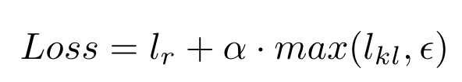
AI-SKETCHER - Loss function
Loss function is modified.

Slide 59
AI-SKETCHER - Loss function
Loss function is modified.
the reconstruction loss
estimates the differences between the generated strokes and the training samples.
estimates the distribution differences between the generated strokes and the strokes in the training set.

Slide 60
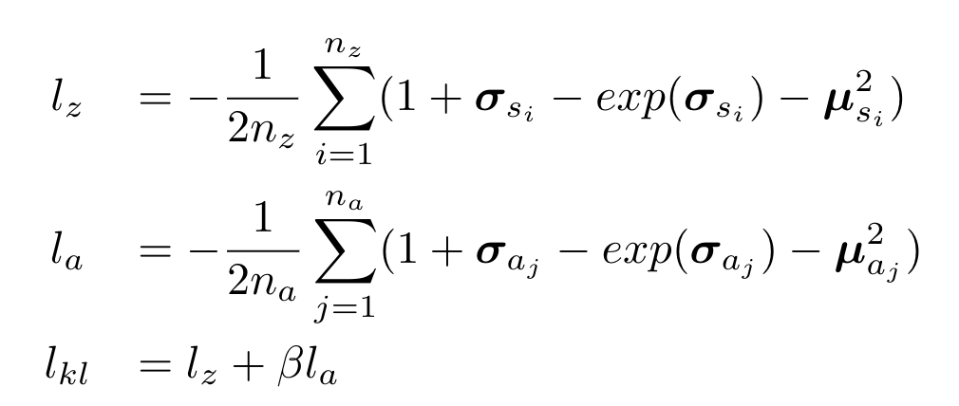
AI-SKETCHER - Loss function
Loss function is modified.

Slide 61
AI-SKETCHER - Loss function
Loss function is modified.
na: the dimensions of ad
na

Slide 62
AI-SKETCHER - Loss function
Loss function is modified.
na: the dimensions of ad
lz / la: the KL divergence between the distribution of the latent vector zs / ad and the distribution of the strokes in the training data
lz
la

Slide 63
AI-SKETCHER - Loss function
Loss function is modified.
na: the dimensions of ad
lz / la: the KL divergence between the distribution of the latent vector zs / ad and the distribution of the strokes in the training data
β：a hyperparameter that balances the two terms
β

Slide 64
EVALUATION
We performed three experiments in purpose of validating:
the AI-Sketcher's drawing quality
its capability of generating sketches from multiple classes
generation diversity
Notes:
generating sketches from multiple classes

Slide 65
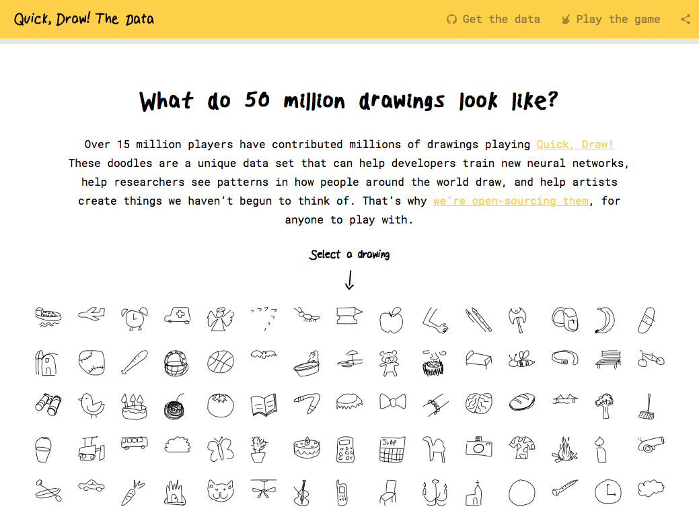
EVALUATION - Dataset
The QuickDraw dataset contains over 50 million sketches in 75 object categories and originally used for training Sketch-RNN.
https://quickdraw.withgoogle.com/
Notes:
这个数据集质量很低，是否会影响生成结果

Slide 66

EVALUATION - Dataset
The FaceX dataset consists of 5 million sketches of both male's and female's facial expressions showing seven different types of emotions.
https://facex.idvxlab.com/

Slide 67
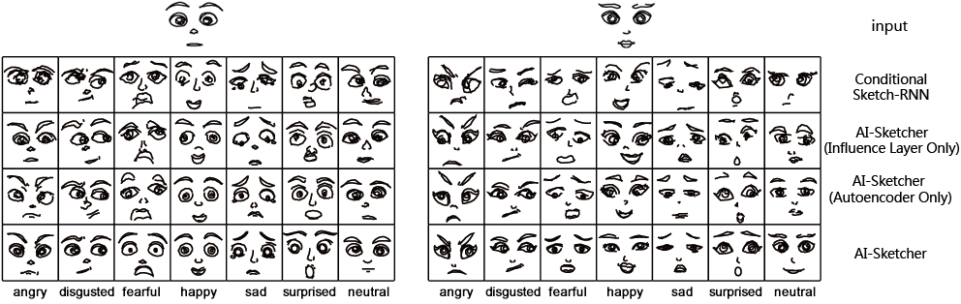
EVALUATION - 1st Experiment
Drawing quality
Experiments based on FaceX Dataset

Slide 68
EVALUATION - 1st Experiment
Drawing quality
Experiments based on FaceX Dataset

Slide 69
EVALUATION - 1st Experiment
Drawing quality
Experiments based on FaceX Dataset

Slide 70
EVALUATION - 1st Experiment
Drawing quality
Experiments based on FaceX Dataset

Slide 71
EVALUATION - 1st Experiment
Drawing quality
Experiments based on FaceX Dataset

Slide 72
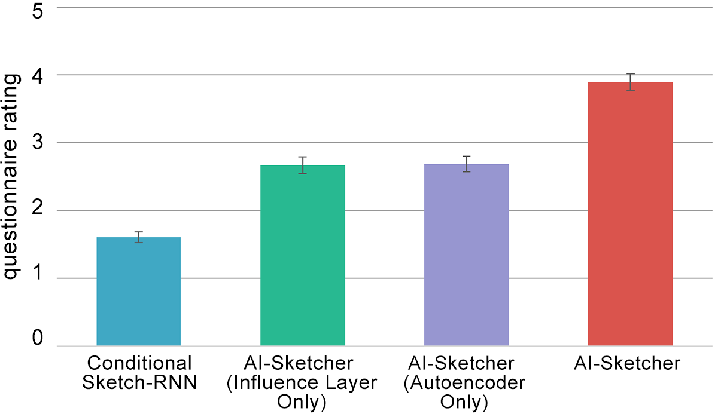
EVALUATION - 1st Experiment
Drawing quality
A within-subject user study
20 participants (10 females)
The repeated measures one way ANOVA analysis showed that the generation quality of AI-Sketcher had an average rating of 3.9 and was significantly better than that of the baseline models (with all p<.01).
Notes:
A within subject user study with 20 participants (10 females) were also performed to let users rate on the quality of total 140 sketches respectively generated by the AI-Sketcher and baseline models based on the same set of inputs.
The 5-Likert scale was used with 1 indicates the quality was ``very poor" and 5 indicates the quality was ``very good". The repeated measures one way ANOVA analysis of the rating results showed that the generation quality of AI-Sketcher had an average rating of 3.9 and was significantly better than that of the baseline models (with all $p<.01$).
提一句就好

Slide 73
EVALUATION - 2nd Experiment
Generating sketches from multiple classes
Experiments
based on QuickDraw Dataset

Slide 74
EVALUATION - 2nd Experiment
Sketch-RNN
Generating sketches from multiple classes

Slide 75
EVALUATION - 2nd Experiment
Sketch-pix2seq
Generating sketches from multiple classes

Slide 76
EVALUATION - 2nd Experiment
AI-Sketcher
Generating sketches from multiple classes

Slide 77
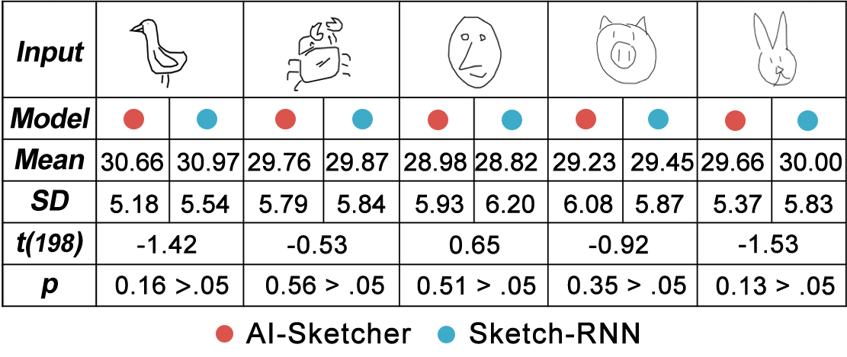
EVALUATION - 3rd Experiment
Generation Diversity
The unpaired t-test showed that AI-Sketcher and Sketch-RNN had no significant difference.
Experiments based on QuickDraw Dataset
Notes:
We also compared the generation diversities of AI-Sketcher and Sketch-RNN based on the QuickDraw dataset.
Specifically, we generated a set of 50 sketches in each of the five pre-selected categories respectively based on AI-Sketcher and Sketch-RNN.
In each set, the pairwised distances between sketches were calculated based on the perceptual hash.
A larger averaged distance indicates a higher generation diversity.
The unpaired t-test showed that AI-Sketcher and Sketch-RNN had no significant difference as shown in Figure~\ref{fig:variation}.

Slide 78
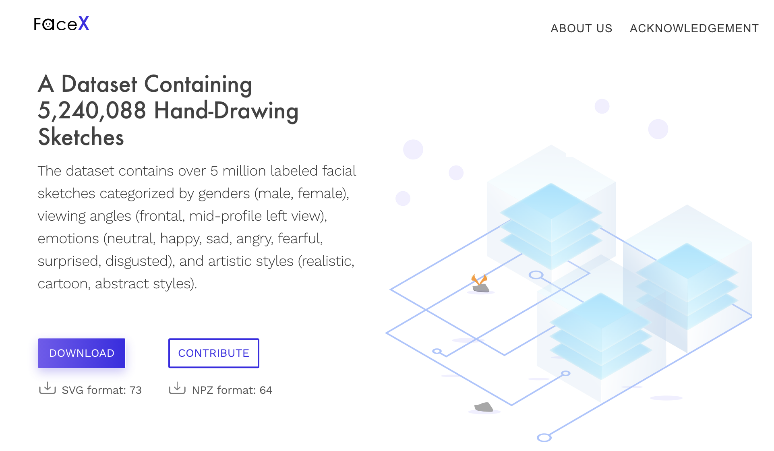
Thank You
Nan Cao, Xin Yan, Yang Shi, Chaoran Chen
https://facex.idvxlab.com/
Intelligent Big Data Visualization Lab
Tongji University

